Slide 1
Geologic Time
Chapter 10
8th Grade

Slide 2
Life and Geologic Time
Geologic Time Scale: The divisions of earths history.

Slide 3
Life and Geologic Time
The break down from large to small:
Eon: Based upon the abundance of certain fossils.
Era: Marked by major, striking, and worldwide changed in the types of fossils present.
Period: characterized by the types of life existing world wide at the time.
Epochs: Smaller units of time, differences in life forms but can sometimes only be from continent to continent.

Slide 4
Early Earth History
During this section we will study Earths early history during the Precambrian Time & the Paleozoic Era.

Slide 5
Precambrian Time
Precambrian time is the longest part of our Earths history including the Hadean, Archean and Proterozoic Eras.
4.5 billion years ago to about 544 million years ago

Slide 6
Precambrian Time
Very little known about the organisms that lived during this time.
Most animals during this time didn’t have hard parts
For example, Cyanobacteria (Visual), a blue/green algae which produced oxygen and underwent photosynthesis.

Slide 7
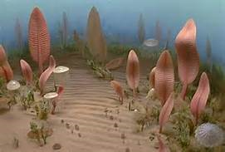
Precambrian Time
Toward the end of the Precambrian Time, animals without backbones started to appear, Invertebrates.
Soft Bodied
Not often fossilized, most which were fossilized are considered trace fossils.

Slide 8
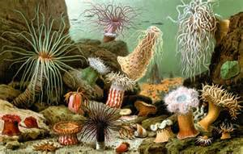
Paleozoic Era
The abundance of hard parted animals like shells marked the beginning of the Paleozoic Era.
544 million years ago to about 248 million years ago.
Many Paleozoic organisms lived in the ocean

Slide 9
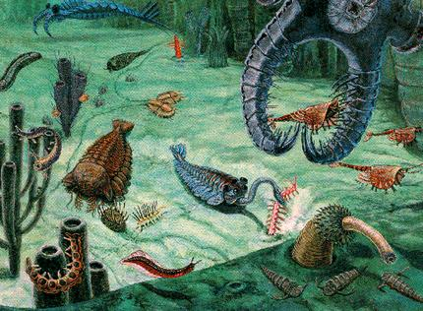
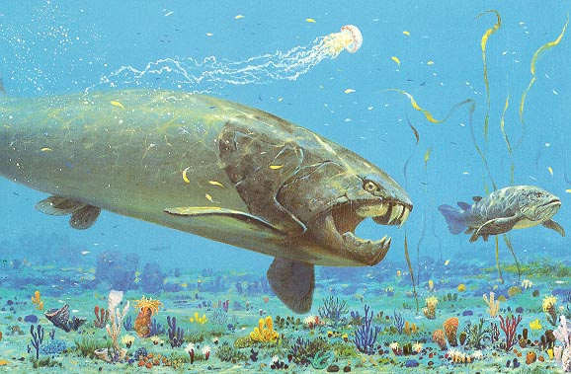
Paleozoic Era
Vertebrates, or animals with backbones, also evolved during this era.
The first, sea creatures without jaws.
Other jawed creatures came around the Devonian period. (On land as well!)

Slide 10
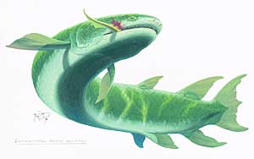
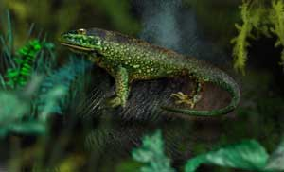
Paleozoic Era
Life on land!!!
(Lung fin fish to Amphibians)
Amphibian to Reptile

Slide 11
Paleozoic Era
Several mountains began forming during this time including the Appalachian. Lowering sea level and causing climate change. All because of Plate tectonics and Seafloor Spreading!!!
This caused 90% of all marine species and 70% of land species to die.

Slide 12
Section 3: Middle and Recent Earth history
Section 1-2 Review:
What differences are found among the organisms that lived in the Precambrian time vs. the Paleozoic era?

Slide 13
Middle & Recent Earth
During this section we will talk about the remaining portions of our geologic time scale including the Mesozoic Era & the Cenozoic Era.

Slide 14
Bell work
What ended the Precambrian time?
What ended the Paleozoic Era?

Slide 15
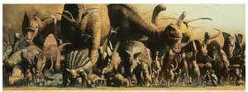
Mesozoic Era
Dinosaurs! Dinosaurs have captured the interest of humans for over 100 Years. These organisms lived during this Mesozoic Era.
248 million years ago to about 65 million years ago.

Slide 16
Mesozoic Era
The breakup of Pangaea!
During the Triassic Period:
It continued to separate over Earths time and eventually formed the continents we see on earth now.

Slide 17
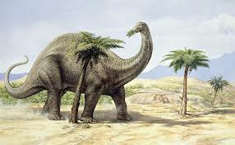
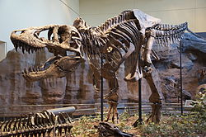
Mesozoic Era
Dinosaurs ranged from 1mm tall to huge animals like Apatosaurus and Tyrannosaurus.
The first small dinosaurs lived during the Triassic and evolved into larger species during the Jurassic and Cretaceous Periods.

Slide 18
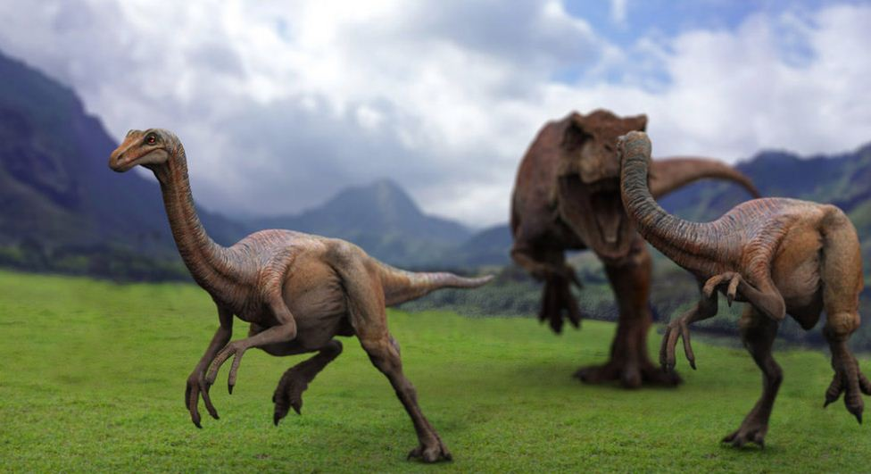
Mesozoic Era
Dinosaurs were active!
Fossil records allowed scientists to calculate how fast they ran (Gallimimus reaching up to 65km—as fast as a modern racehorse).
May have been more fast moving and warm blooded like present day mammals and birds rather than cold blooded reptile like animals.

Slide 19
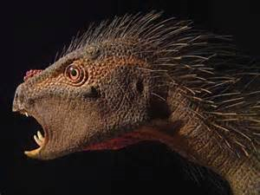
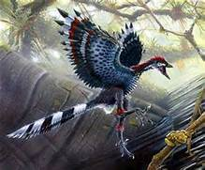
Mesozoic Era
May have been more fast moving and warm blooded like present day mammals and birds rather than cold blooded reptile like animals.

Slide 20
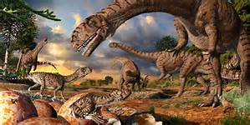
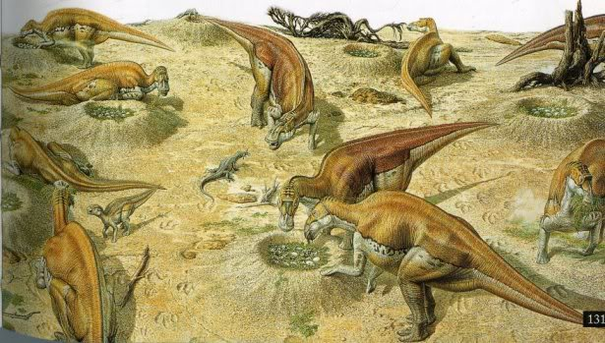
Mesozoic Era
Fossil records also suggest that some dinosaurs may have nurtured and cared for their young.
Maiasaura
Build nests
Raised offspring in close clusters.

Slide 21
Mesozoic Era
Birds first appeared during the Jurassic Period.
Archaeopteryx evolved from the Bambiraptor Feinberger.

Slide 22
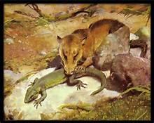
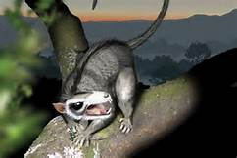
Mesozoic Era
Mammals first appeared in the Triassic Period.
First mammals were small mouse like creatures.

Slide 23
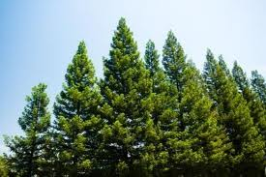
Mesozoic Era
Gymnosperms: plants that produced seeds but not flowers dominated the land during the Mesozoic Era.
Angiosperms: flowering plants, first appeared in the cretaceous period.

Slide 24
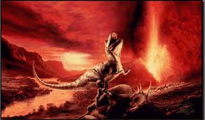
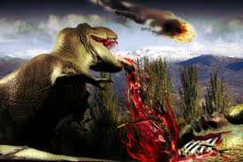
Mesozoic Era
Mesozoic Era ended with a major extinction of land and marine animals.
Many species, including dinosaurs, disappeared suddenly during this time.
Many causes have been hypothesized but none have been proven.

Slide 25
Cenozoic Era
Era of recent life
65 million years ago and continues today.
Broken up into two periods: Tertiary and Quaternary
Includes massive climate changes like ice ages.

Slide 26
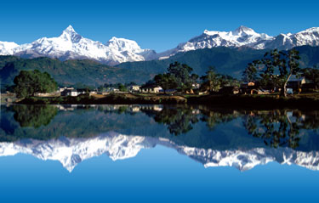
Cenozoic Era
Many mountain ranges have formed during this recent Era including the Himalaya Mountains along India and Tibet.

Slide 27
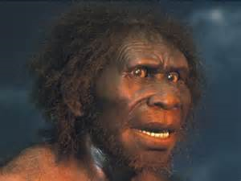
Cenozoic Era
Expanding grasslands have favored mammals like deer, horse, camels, and some elephants.
Mammals now rule our earth and even live in the sea
Whale and dolphin species.
Homo Sapiens: Humans
Appeared 140,000 years ago.

Slide 28
Evolution of Primates

Slide 29
Chapter Review
Review/Overview
https://youtu.be/sjE-Pkjp3u4 Crash course
https://youtu.be/hSSzn4bIwZg evolutionary process animation

Slide 30
Project
Include:
Plants
Animals
Time range
Environment/land
Pictures/diagrams
Words/descriptions
TITLE!!!

Slide 31
Making our Timeline
Each group will master their time period
Precambrian time
Paleozoic era
Mesozoic era
Cenozoic era
Group 5 will be making the outline of the entire geologic time scale. Their project will be complete when the rest of the groups insert their poster within the time scale.

Slide 32
Life and Geologic Time
Organic Evolution: Fossil records show that species of animals have changed over geologic time.
Helps an animal to survive in the changing environment and continue to reproduce.

Slide 33
Life and Geologic Time
Natural Selection: organisms who have characteristics that fit the environment have a better chance of surviving.
Organisms compete with each other for food, water, and shelter.
Organisms of the same species could have different characteristics that hurt or help them.

Slide 34
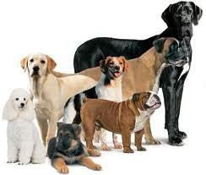
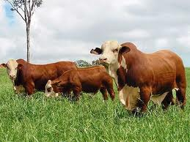
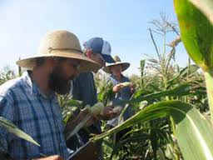
Life and Geologic Time
Artificial Selection: Humans use this for breeding animals . They carefully choose desired characteristics. For example, breeding cattle, dogs, cats, chickens, even plants.

Slide 35
Compare and Contrast
In your science journal, make a Venn diagram to compare and contrast natural selection vs. artificial selection.

Slide 36
Life and Geologic Time
Have you heard of Trilobites??
They have three lobes and three segments in its body.
They existed on earth for over 200 million years because they were great at evolving to fit their environment.

Slide 37
Life and Geologic Time
Visuals of Trilobites and their evolution
Pages 277-278

Slide 38
Life and Geologic Time
Chapter 10 Section 1 Review Questions # 1 & 5 only

Slide 39
Sec 1: LAB
The Beak Adaptation Lab

Slide 40
Announcements
Beak Lab due TODAY

